Slide 1
Molecular Biology Laboratory BT 453
Laboratory No. 3
DNA Analysis & Quantitation

Slide 2
OBJECTIVES
Understand how to quantify extracted nucliec acids and determine its purity using either UV absorbance spectroscopy or gel electrophoresis methods
Contrast between the above methods and discuss the quantity and purity requirement for diverse downstream molecular testing.
To analyse the effect of different degradation treatment on DNA integrity.

Slide 3
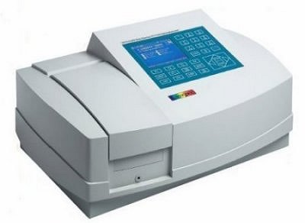
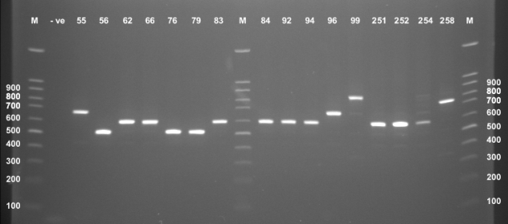
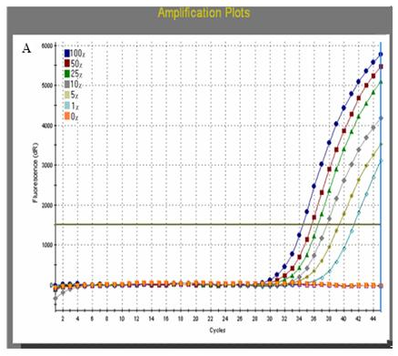
Methods
Spectrophotometery
Gel electrophoresis
Real-time PCR

Slide 4
Spectrophotometery
Used to
Determine the concentration of a substance in solution
Principle
Measures light absorbed by solution at a specific wavelength
In our case
Determine the concentration of nucleic acids
Check the purity of the extracted nucleic acids
MBL. BT453

Slide 5
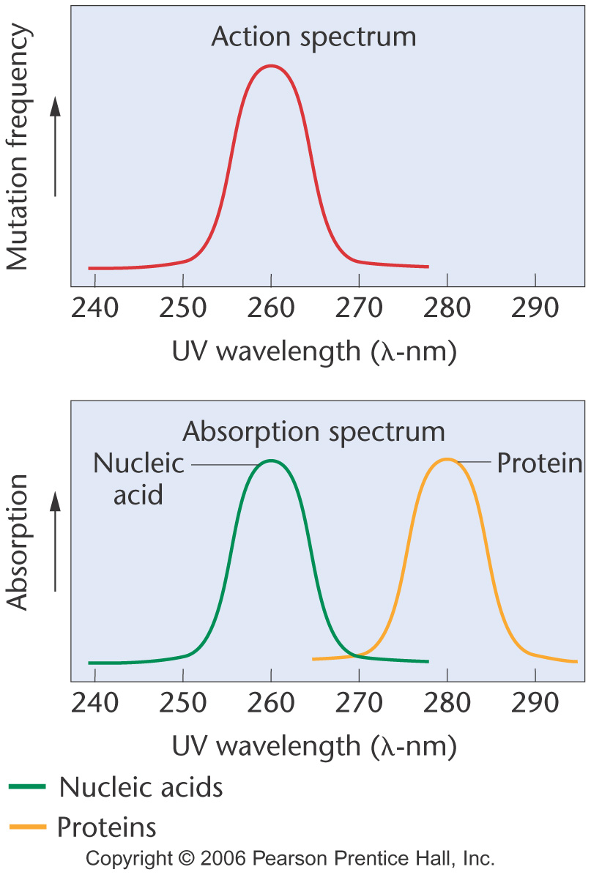
Spectrophotometery of Nucleic acids
The amino acids tryptophan, tyrosine absorb light in the UV wavelength
Aromatic rings in the bases of nucleic acids also absorb light in the UV range
MBL. BT453

Slide 6
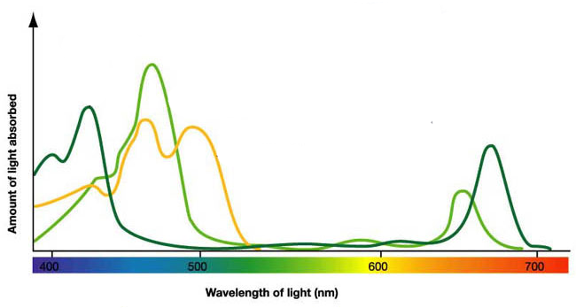
Spectrophotometery
Campbell A. and Reece B. (2001). Biology. 6th edition, Benjamin Cummings
MBL. BT453

Slide 7

Spectrophotometers
Monochromator
Detector
Lamp
Cuvette
Source of visible & UV spectra
isolate a specific wavelength and allow it to pass through the solution being analyzed
Where the sample is placed
Detects how much light is absorbed/transmitted by/from the sample
MBL. BT453

Slide 8
Beer-Lambert’s Law
A = ε c l
Where: A = light absorbed by the sample
ε = molar extinction coefficient
c = concentration of the absorbing species (mol/L)
l = path length of the light-absorbing sample (cm)
MBL. BT453

Slide 9
Beer-Lambert’s Law
The fraction of the incident light absorbed by a solution at a given wavelength is related to:
Thickness of the absorbing layer (path length), which is constant
Concentration of the absorbing species
Absorbance α to concentration
MBL. BT453

Slide 10
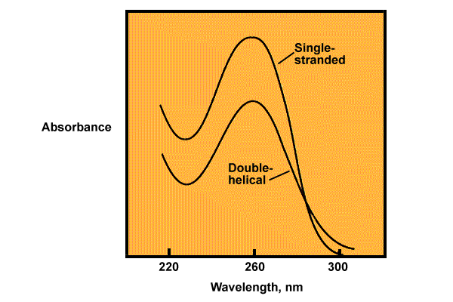
Concentration of Nucleic acids
[dsDNA] ≈ A₂₆₀ x (50 µg/mL) x Dilution factor
[ssDNA] ≈ A₂₆₀ x (33 µg/mL) x Dilution factor
[ssRNA] ≈ A₂₆₀ x (40 µg/mL) x Dilution factor
http://abe.leeward.hawaii.edu/WebSharing/Nucleic%20Acid%20Isolation.ppt
MBL. BT453

Slide 11
Example of Calculation
A sample of dsDNA was diluted 50X. The diluted sample gave a reading of 0.65 on a spectrophotometer at A₂₆₀. To determine the concentration of DNA in the original sample, perform the following calculation:
[dsDNA] = 50 μg/mL × A260 × dilution factor
[dsDNA] = 50 μg/mL × 0.65 × 50
[dsDNA] = 1.63 mg/mL

Slide 12
Purity of Nucleic acids
dsDNA purity = A₂₆₀ / A₂₈₀
A ratio between 1.8 and 2.0 indicates that the DNA sample is pure.
Elevated ratios usually indicate the presence of RNA
Ratios below 1.8 often signal the presence of contaminating protein, or phenol (from the extraction protocol)
ssRNA purity = A₂₆₀ / A₂₈₀
A ratio between 2.2 and 2.3 indicates that the RNA sample is pure.
MBL. BT453

Slide 13
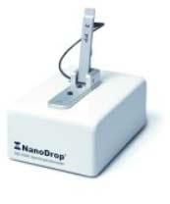
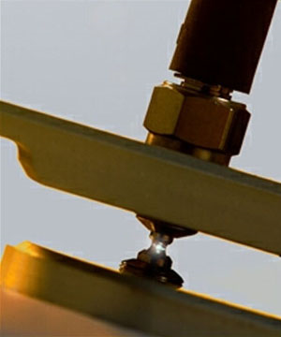
New technology (NanoDrop)
NanoDrop ND1000
Small sample size:
only 1 – 2 μL!
No sample dilution:
measures up to 3700 ng/ul
Fast and easy to use
Stores data on computer
Converts OD to molarity
MBL. BT453

Slide 14
How does it work?
Fiber optic cable in measurement arm
Sample (1-2 μL)
Receiving fiber (fiber optic cable)
Xenon lamp
Spectrophotometer
MBL. BT453

Slide 15
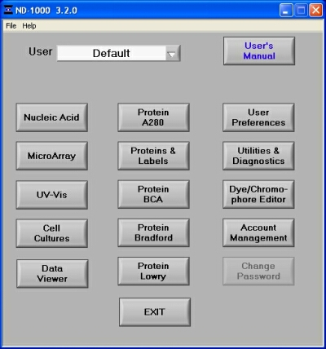
Using the ND1000
Turn on PC
Open NanoDrop program
Select “DNA” from menu
http://www.nanodrop.com/nd-1000-software.html
MBL. BT453

Slide 16
Using the ND1000
Lift arm
Place 1 μL water on pedestal to initialize instrument
BLANK instrument using water or elution buffer
Place 1-2 μL of DNA sample on pedestal
Click “MEASURE” on instrument screen
Recover sample if precious, or clean pedestals using a lab wipe
http://www.nanodrop.com/nd-1000-software.html
MBL. BT453

Slide 17
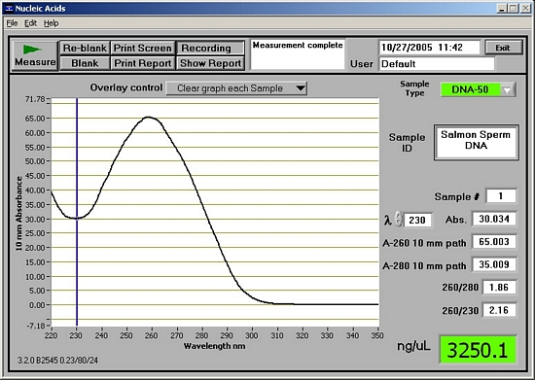
NanoDrop Data Screen
Protein contamination
Other contamination
Concentration
MBL. BT453

Slide 18
Gel electrophoresis
Electrophoresis is a technique used to separate and purify macromolecules - especially proteins and nucleic acids - that differ in size, charge or conformation.
DNA molecules migrate in an electrical field at a rate that is inversely proportional to the log10 of molecular size (number of base pairs).
DNA possesses a net negative charge and migrates towards the positively charged anode.
MBL. BT453

Slide 19
Purposes for Agarose Gel Electrophoresis
Analysis of DNA size and conformation
Separation and extraction of DNA fragments
DNA Quantitation
DNA degradation
Sizing of Nucleic Acid Molecules
DNA fragments for Southern transfer analysis
RNA molecules for Northern transfer analysis
Analytical separation of PCR products
Detection of Mutations or Sequence Variations
MBL. BT453

Slide 20
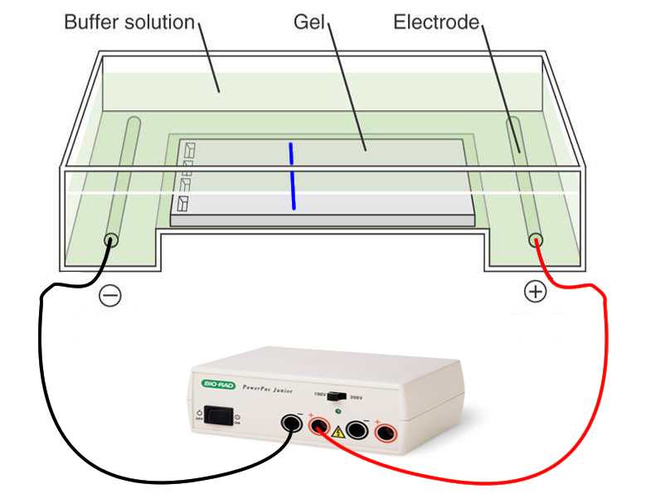
Components of an Electrophoresis System
Supporting Media
Buffer
Electrode
Electrophoresis chamber
Loading dye
Power supply
MBL. BT453

Slide 21
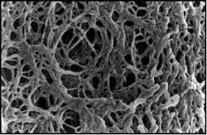
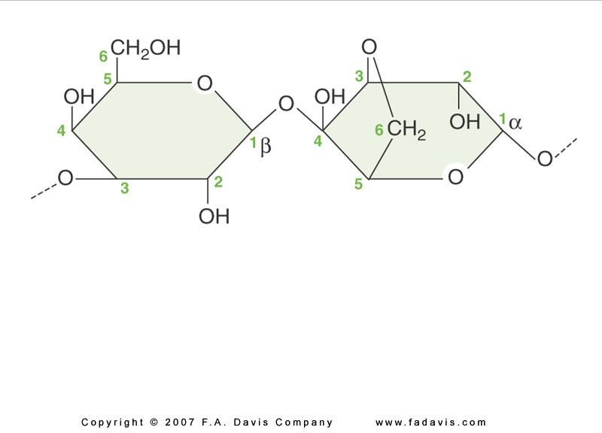
Support Media (Agarose)
A porous material derived from red seaweed
A chain of sugar molecules
D-Galactose + 3,6-anhydrous-L-Galactose
Porous Material
Proteins Entering Porous Material
Smallest Move Fastest
MBL. BT453

Slide 22
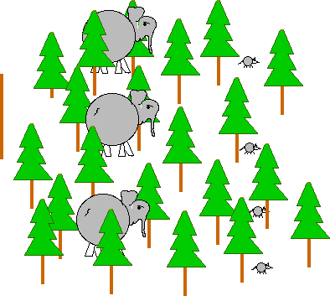
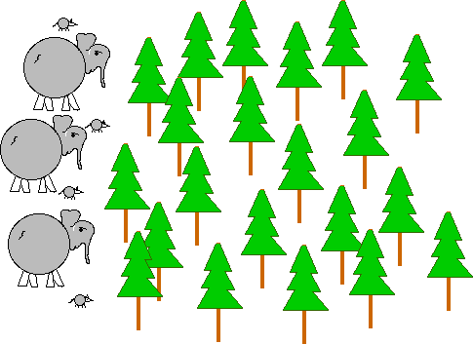
Support Media (Agarose)
Acts as a sieve for separating DNA fragments; Smaller fragments travel faster than large fragments
Concentration of agarose affects DNA migration
Low [agarose] = larger pores → better resolution of larger DNA fragments
High [agarose] = smaller pores → better resolution of smaller DNA fragments
MBL. BT453

Slide 23
Support Media (Agarose)
Range of separation of linear DNA (in kilobases) | Agarose (%)
60 - 5 | 0.3
20 - 1 | 0.6
10 - 0.8 | 0.7
7 - 0.5 | 0.9
6 - 0.4 | 1.2
4 - 0.2 | 1.5
3 - 0.1 | 2.0
MBL. BT453

Slide 24
Power supply & Buffers
Power supply and chamber
A source of negatively charged particles with a cathode and anode
Buffer
A fluid mixture of water and ions, having the following functions:
Carries the applied current
Maintain the pH (pH 8)
Determine the electric charge on the solute
Types of buffers commonly used:
Tris-Borate-EDTA (TBE): Greater buffering capacity and gives better resolution with shaper bands
Tris-Acetate-EDTA(TAE): Lower buffering capacity and mainly used when DNA are purified from the agarose gels
MBL. BT453

Slide 25
Loadying Dye & DNA stain
Loading Dye
which contains:
Dense material (e.g. glycerol or sucrose): to allow the sample to "fall" into the sample wells
Tracking dyes (e.g. xylene cyanol / bromophenol blue)
Migrate in the gel and allow visual monitoring or how far the electrophoresis has proceeded
DNA Stains
Several hydrophobic molecules containing flat aromatic and fused heterocyclic rings can insert between the stacked base pairs of DNA. These molecules are called intercalating agents.
Intercalating agents are potential Cancer-inducing reagents.
MBL. BT453

Slide 26
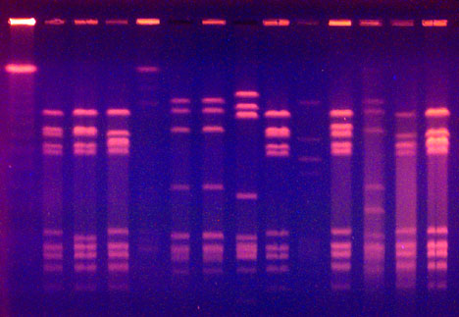
An ethidium-stained gel photographed under UV light
http://www.ams.cmu.ac.th/mt/clinchemwebsite/teaching/510204/ElectrophoresisI204_RCr.ppt
When ethidium bromide is exposed to ultraviolet light, it will fluoresce with an orange colour, intensifying almost 20-fold after binding to DNA.
Each band that you see is a collection of millions of DNA molecules, all of the same length!!
MBL. BT453

Slide 27
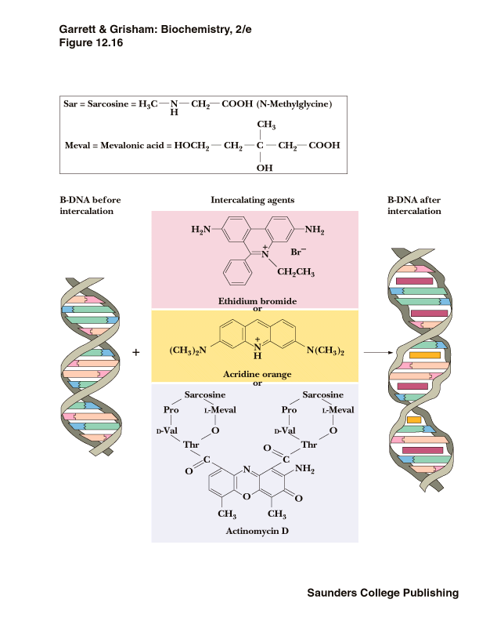
DNA stains
http://faculty.ksu.edu.sa/73637/Documents/DNA%20isolation.ppt.
MBL. BT453

Slide 28
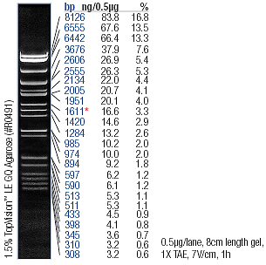
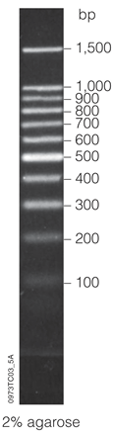
DNA markers
DNA markers are a mixture of DNA fragments of known lengths
DNA marker
100 bp ladder
www.fermentas.com
www.Promega.com
MBL. BT453

Slide 29
The rate of migration of DNA is determined by
The charge on the DNA
The strength of the electrical field
The size of the DNA
The shape of the DNA
The state of hydration of the DNA
The viscosity of the solution
The pore size of the gel.
DNA stains
MBL. BT453

Slide 30
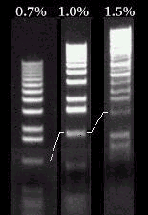
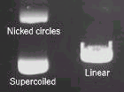
The rate of migration of DNA
% Agarose
The shape of plasmid
rtfw.james.googlepages.com/James_GelElectro_Spring07.ppt
rtfw.james.googlepages.com/James_GelElectro_Spring07.ppt
MBL. BT453

Slide 31
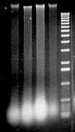
Checking for Degradation: DNA
genomic
DNA
Running your sample through an agarose gel is a common method for examining the extent of DNA degradation. Good quality DNA should migrate as a high molecular weight band, with little or no evidence of smearing.
RNA
(degraded)
http://abe.leeward.hawaii.edu/WebSharing/Nucleic%20Acid%20Isolation.ppt
MBL. BT453

Slide 32
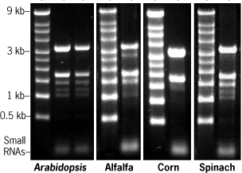
Checking for Degradation: RNA
Ribosomal RNA (rRNA) makes up more than 80% of total RNA samples. Total RNA preps should display two prominent bands after gel electrophoresis. These correspond to the 25S and 18S rRNAs, which are 3.4 kb and 1.9 kb in Arabidopsis (respectively).
Good quality RNA will have:
No evidence of smearing
25S/18S ratio between 1.8 - 2.3
25S
18S
http://abe.leeward.hawaii.edu/WebSharing/Nucleic%20Acid%20Isolation.ppt
MBL. BT453

Slide 35
Laboratory No.
Your samples
Agarose Gel electrophoresis
Spectrophotometer
NanoDrop
DNA samples
Physical degradation
Biological degradation
Chemical degradation
Agarose Gel Electrophoresis

Slide 36
WORK FLOW CHART
Laboratory No. 3 &4
Laboratory No. 1&2
Bacteria
Blood
Bacteria
Blood
Plasmid
RNA
DNA
DNA
Laboratory No.5
Quantitation & Analysis
Agarose Gel electrophoresis
Spectrophotometer
Nanodrop

